Slide 1
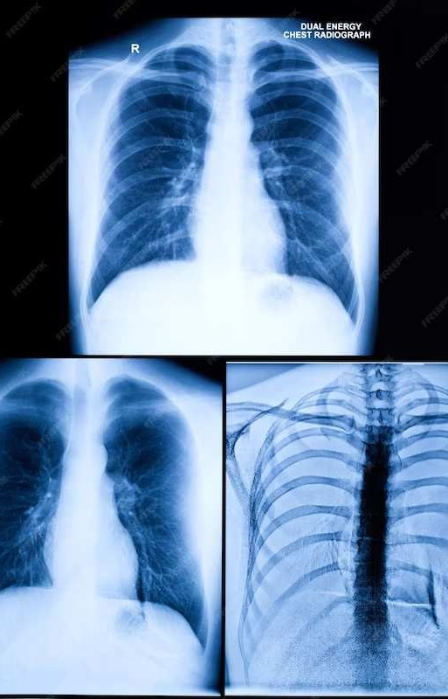
Chest X-ray Analysis
Mentor Dinesh Singh
Mentor – Dr. Dinesh Singh
Vivek Jaiswal B20172
Aryan Ali B20279

Slide 2
Problem Statement
Chest X-ray (CXR) interpretation suffers from inconsistencies, and missed crucial findings, challenging patient care. The need for precise analyses is evident, particularly with the reported 19% oversight in early lung cancer nodules.
Driven by a desire to revolutionize healthcare, our project aims to develop an intelligent system for quick and accurate diagnosis ny pixel level localisation of chest x-rays, enabling physicians to put patient care ahead of time-consuming picture analysis and guaranteeing correct and timely therapies.
Aryan Ali B20279 Chest X-Ray Analysis Vivek Jaiswal B20172

Slide 3
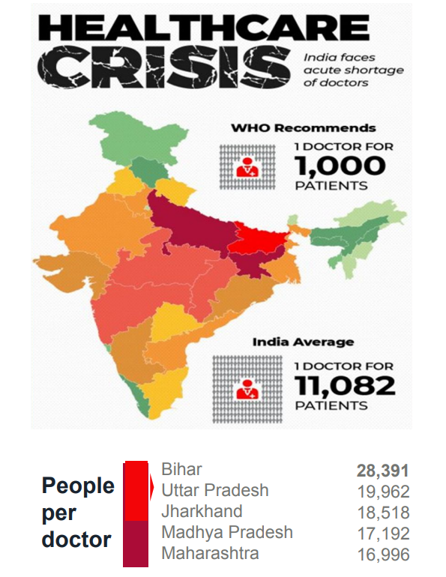
Motivation
Due to the lack of radiologists in India, doctors struggle with the burden of doing laborious chest X-ray reviews, which puts them at danger of making mistakes.
Transforming CXR interpretation through AI promises enhanced diagnostic accuracy, reducing oversights and improving patient outcomes, addressing critical concerns in healthcare quality and malpractice risks.
Ref: Kaviani, Parisa, et al. "Frequency of missed findings on chest radiographs (CXRs) in an international, multicenter study: application of AI to reduce missed findings." Diagnostics 12.10 (2022): 2382.
Aryan Ali B20279 Chest X-Ray Analysis Vivek Jaiswal B20172

Slide 4
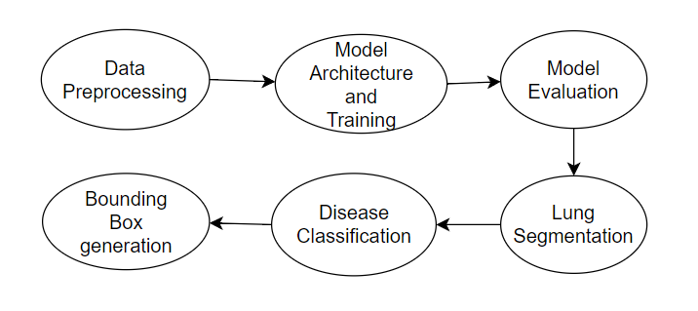
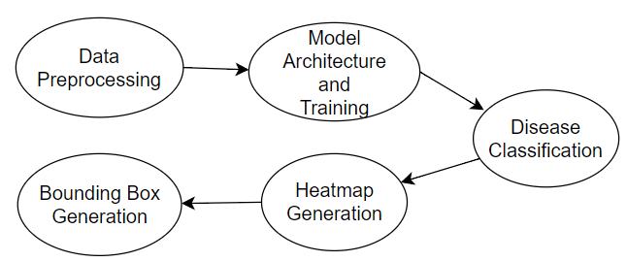
Model Formulation Approach
Aryan Ali B20279 Chest X-Ray Analysis Vivek Jaiswal B20172

Slide 5
Image Segmentation
Models Used :
UNet : Specialized for image segmentation, utilizes encoder for features and decoder for pixel-wise maps.
Deeplab-v3 : good in semantic segmentation, employs dilated convolutions for multi-scale object details .
ResUnet : precise medical image segmentation by combining resnet and unet.
Dataset used :
Total number of Samples : 800.
Total number of masks : 700
Image Dimension : 1024*1024
Data Split :
Train : 630
Validation : 70
Test : 100
Aryan Ali B20279 Chest X-Ray Analysis Vivek Jaiswal B20172

Slide 6
Results Comparisons for image Segmentation
Models | Average Dice Score for Segmentation
UNet | 0.94
Deeplab v3 | 0.88
ResUNet | 0.96
Aryan Ali B20279 Chest X-Ray Analysis Vivek Jaiswal B20172

Slide 7
Data Distribution
Disease | Number of Samples
Atelectasis | 5789
Cardiomegaly | 1010
Effusion | 6331
Infiltration | 10317
Mass | 6046
Nodule | 1971
Pneumonia | 1062
Pneumothorax | 2793
Total number of Samples : 108948.
Total Normal Samples : 84312
Total bounding box samples : 1000
Image Dimension : 1024*1024
Data Split :
Train : 70% (76264)
Validation : 10% (10894)
Test : 20% (21790)
Aryan Ali B20279 Chest X-Ray Analysis Vivek Jaiswal B20172

Slide 8
Data Transformations
Resize:
Transform images to a standardized size.
Input Size: 1024x1024 pixels , Output Size: 512x512 pixels.
ToTensor:
Convert images into PyTorch tensors.
Necessary for compatibility with neural network models.
Normalize:
Standardize pixel values for improved model training.
Subtract mean values and divide by standard deviation
Aryan Ali B20279 Chest X-Ray Analysis Vivek Jaiswal B20172

Slide 9
Proposed Method-1
The model uses a ResNet-152 architecture as a backbone. ResNet is a deep convolutional neural network architecture known for its effectiveness in image classification tasks.
The ResNet model is truncated after the first three layers (conv1, bn1, relu) for the layer0, and only the first layer of layer 1 is used.
Four instances of GCM are applied at different scales, taking feature maps from different ResNet layers (layer 1 to layer 4).
Applies nine instances of Boundary Refinement Network (brm1 to brm9) for boundary refinement.
Ref : Wang, Xiaosong, et al. "Chestx-ray8: Hospital-scale chest x-ray database and benchmarks on weakly-supervised classification and localization of common thorax diseases." Proceedings of the IEEE conference on computer vision and pattern recognition. 2017.
Aryan Ali B20279 Chest X-Ray Analysis Vivek Jaiswal B20172

Slide 10
The model uses bilinear upsampling to increase the spatial resolution of the feature maps.
The upsampled feature maps from higher layers are fused with the feature maps from lower layers to refine segmentation results.
The final output is obtained after a series of upsampling and boundary refinement operations, resulting in a segmentation map.
The segmentation map is used to identify regions of interest in the input chest X-ray image.
Aryan Ali B20279 Chest X-Ray Analysis Vivek Jaiswal B20172

Slide 11
Mathematical Expressions
Model 1 Module (GCN class):
GCN Output=ResNet 152 Backbone +∑GCM+∑BRM
Main Model (Model class):
Segmentation Output=GCN Output
Feature Extraction Output=Convolutional Operations(Segmentation Output)
Classifier Output=Fully Connected Layers(Feature Extraction Output)
Final Output=Sigmoid Activation(Classifier Output)
Aryan Ali B20279 Chest X-Ray Analysis Vivek Jaiswal B20172

Slide 12
Significance
Global Context Module (GCM)
The module is named "Global Context" because it aims to capture global contextual information across the input feature map by applying convolutions in both vertical and horizontal directions.
The use of two separate convolutions in each direction allows the module to learn complex relationships between spatially distant pixels.
The module is intended to enhance the ability of the neural network to understand global patterns and structures in the input feature maps, which can be beneficial for tasks like image segmentation where global context is crucial.
Aryan Ali B20279 Chest X-Ray Analysis Vivek Jaiswal B20172

Slide 13
Significance
Boundary Refinement Module (BRM)
The module is named "Boundary Refine" because its purpose is to refine boundaries within the input feature maps.
The use of two consecutive convolutions with ReLU activation helps capture and enhance the nuanced information at the boundaries of objects or regions in the feature maps.
The skip connection through addition of the residual to the original input facilitates the flow of information through the network and helps mitigate the vanishing gradient problem
Aryan Ali B20279 Chest X-Ray Analysis Vivek Jaiswal B20172

Slide 14
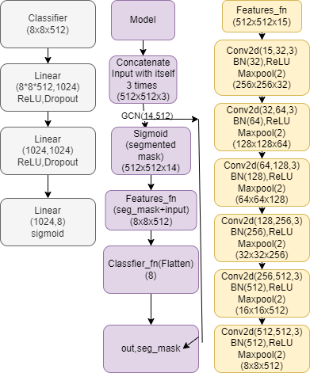
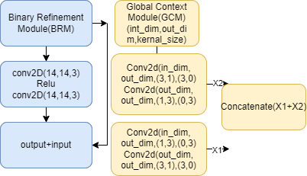
Architecture
Aryan Ali B20279 Chest X-Ray Analysis Vivek Jaiswal B20172

Slide 15
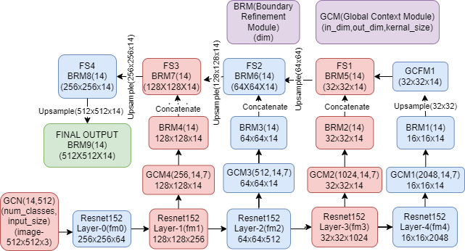
Architecture
Aryan Ali B20279 Chest X-Ray Analysis Vivek Jaiswal B20172

Slide 16
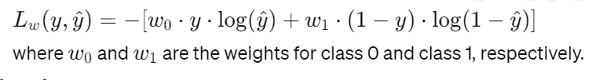
Weighted Binary Cross-Entropy
Mathematical Expression:
Weights are calculated based on the number of positive and negative instances in the dataset, with the intention of addressing class imbalance during training.
Aryan Ali B20279 Chest X-Ray Analysis Vivek Jaiswal B20172

Slide 17
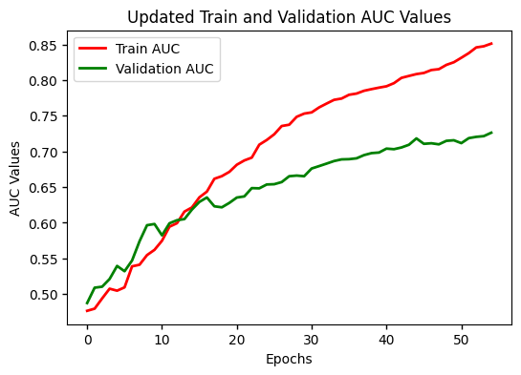
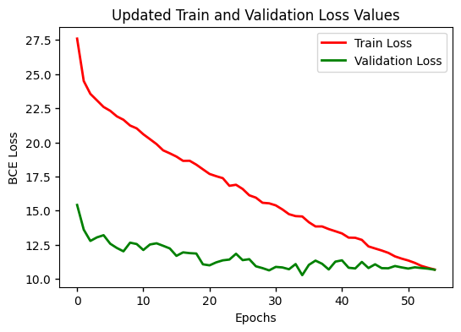
GCN Loss and AUC Plot
Aryan Ali B20279 Chest X-Ray Analysis Vivek Jaiswal B20172

Slide 18
Proposed Method-2
DenseNet-121
Fine-tuned DenseNet121, a renowned architecture particularly used in healthcare datasets, for feature reuse and efficient parameter utilization.
Dense connectivity facilitates strong gradient flow, enabling effective backpropagation and addressing the vanishing gradient problem.
Random cropping and flipping diversified training data, improving model generalization across various orientations and scenarios.
Adapted label weights based on class frequencies to counter class imbalance, ensuring model fairness and robust predictions.
DenseNet has achieved state-of-the-art performance on various benchmarks, showcasing its efficacy in image classification tasks with lower error rates.
Ref : Huang, Gao, et al. "Densely connected convolutional networks." Proceedings of the IEEE conference on computer vision and pattern recognition. 2017.
Aryan Ali B20279 Chest X-Ray Analysis Vivek Jaiswal B20172

Slide 19
Significance of DenseNet-121
Dense connectivity reduces the number of parameters, promoting computational efficiency, making DenseNet a scalable and resource-efficient deep learning architecture.
DenseNet's adaptability to binary classification tasks and versatility in handling various medical imaging scenarios make it a robust and applicable model in diverse domains.
Unlike traditional networks, DenseNet maintains low-complexity features throughout the network, utilizes features of all levels ensuring a holistic representation for improved model interpretability and diagnosis reliability.
Aryan Ali B20279 Chest X-Ray Analysis Vivek Jaiswal B20172

Slide 20
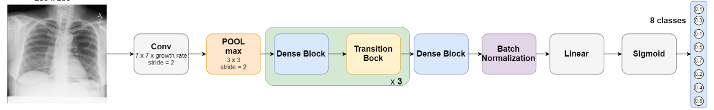
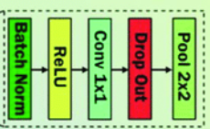
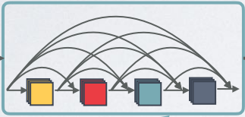
Architecture
Aryan Ali B20279 Chest X-Ray Analysis Vivek Jaiswal B20172

Slide 21
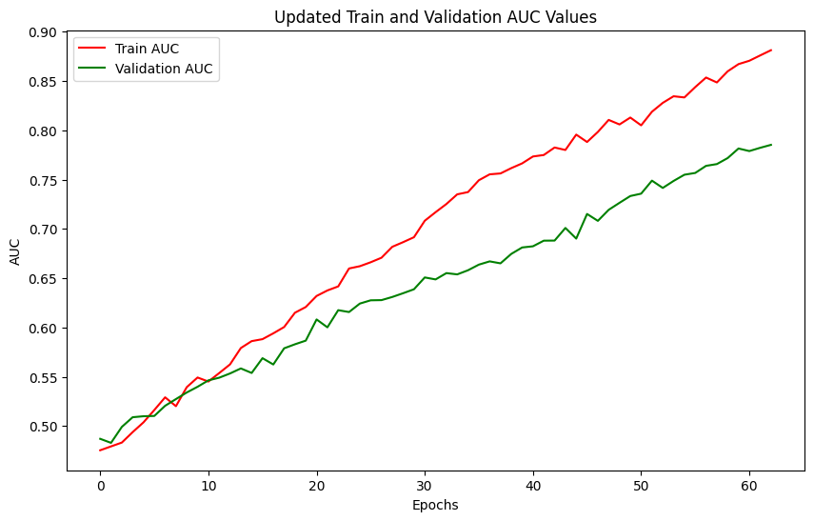
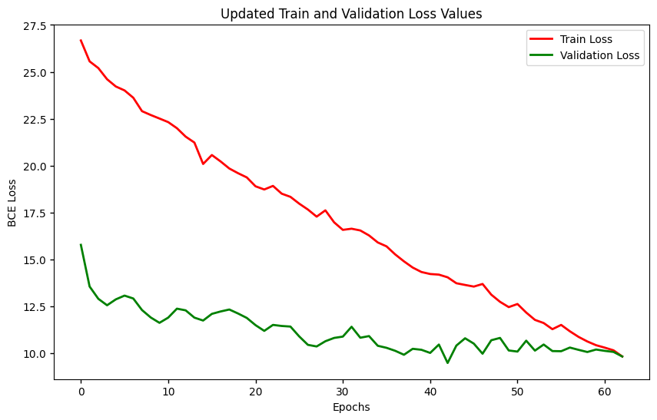
DenseNet-121 Loss and AUC Plot
Aryan Ali B20279 Chest X-Ray Analysis Vivek Jaiswal B20172

Slide 22
Inception V3
Inception V3 is a convolutional neural network architecture developed by Google Research.
Key Features of Inception V3
Inception Modules: These are building blocks of the network that perform convolution operations at multiple scales simultaneously, aiding in feature extraction.
Factorization: Inception V3 utilizes factorized convolutions to reduce computational complexity while maintaining expressive power.
Auxiliary Classifiers: Introduces auxiliary classifiers at intermediate layers during training, aiding in the training process and regularization.
Ref : Tamura, Masato, and Tomoaki Yoshinaga. "Segmentation-based bounding box generation for omnidirectional pedestrian detection." The Visual Computer (2023): 1-12.
Aryan Ali B20279 Chest X-Ray Analysis Vivek Jaiswal B20172

Slide 23
Significance of Using Inception V3
Multi-Scale Feature Extraction: Inception modules incorporate filters of multiple sizes within the same layer. This enables the network to capture features at different scales, enhancing its ability to recognize patterns in the input images effectively.
Reduced Computational Cost: Inception Net v3 employs 1x1 convolutions to reduce the dimensionality of feature maps before applying larger convolutions. This helps in reducing computational cost without compromising the model's representational power. With chest X-ray images, which are typically high-resolution, optimizing computational efficiency is essential, especially in resource-constrained environments like healthcare settings
Aryan Ali B20279 Chest X-Ray Analysis Vivek Jaiswal B20172

Slide 24
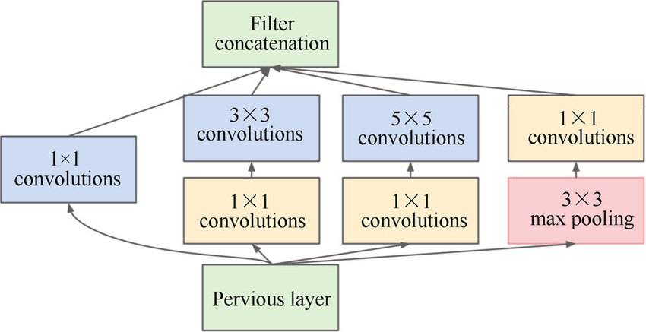
Inception Module
Ref : Szegedy, Christian, et al. "Going deeper with convolutions." Proceedings of the IEEE conference on computer vision and pattern recognition. 2015.
Aryan Ali B20279 Chest X-Ray Analysis Vivek Jaiswal B20172

Slide 25
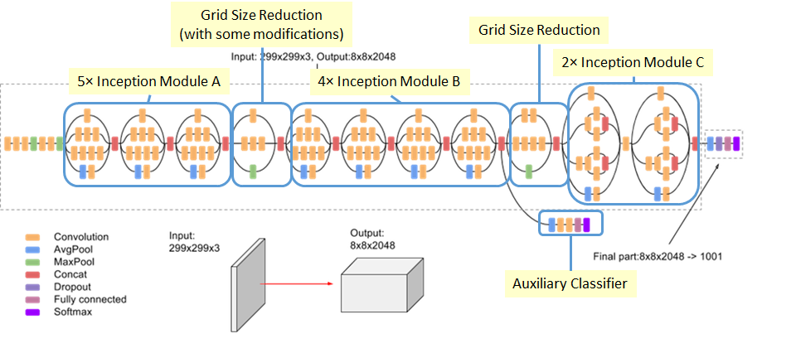
Inception V3 Architecture
Ref : https://github.com/Sakib1263/Inception-Model-Builder-Tensorflow-Keras/blob/main/Documents/Images/Inception_v3.png
Aryan Ali B20279 Chest X-Ray Analysis Vivek Jaiswal B20172

Slide 26
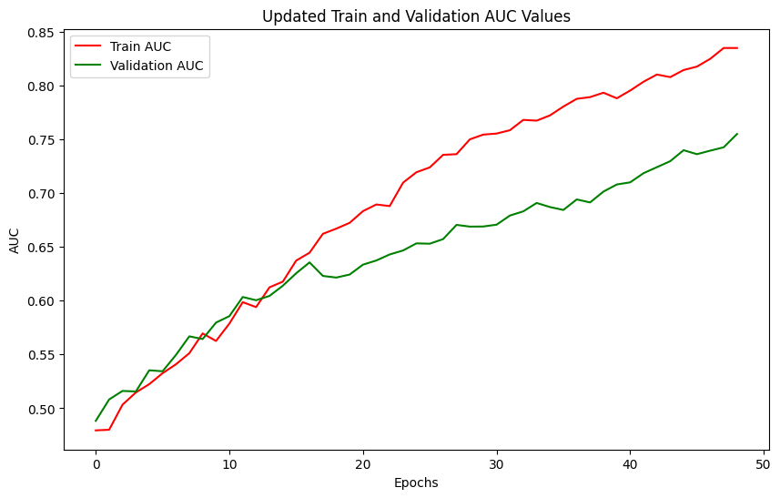
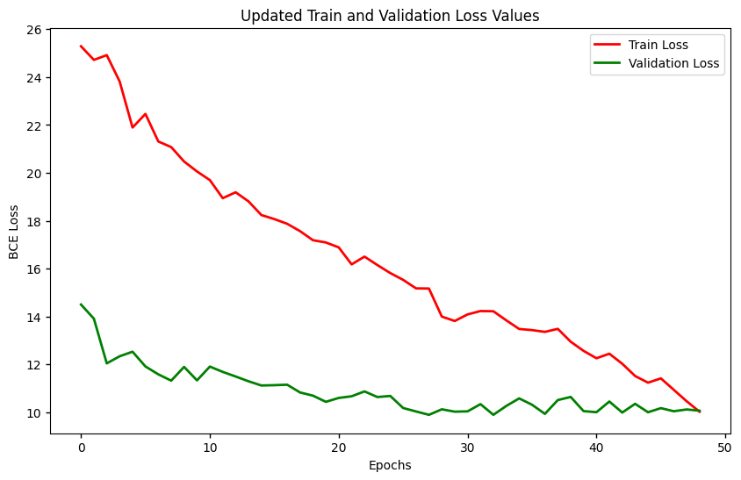
Inception V3 Loss and AUC Plot
Aryan Ali B20279 Chest X-Ray Analysis Vivek Jaiswal B20172

Slide 27
Vision Transformer
The key idea is to apply the transformer architecture, which has been highly successful in NLP tasks, to the task of image classification.
Significance :
ViT inherently captures global context through self-attention, which helps in recognizing relationships between distant patches. CNNs rely on pooling layers for coarse global information.
Attention mechanism provides interpretable insights into image classification decisions, enhancing transparency.
Parameter efficient architecture enables ViT to achieve competitive performance with fewer parameters than CNN.
CNNs often require large amounts of labeled data for training, whereas ViT can benefit from pre-training on large datasets and then fine-tuning on specific tasks.
Aryan Ali B20279 Chest X-Ray Analysis Vivek Jaiswal B20172

Slide 28
Key Component
Input Representation : Unlike traditional CNN, which operates directly operates directly on image pixels, ViT first converts the input images into sequences of fixed-size patches. Each patch is treated as a token similar to words in NLP task.
Patch Embeddings: Linearly project each image patch to a lower-dimensional space, serving as input for subsequent transformer processing.
Positional Encoding: Adds positional information into tokens, ensuring the model understands the order of tokens in the sequence.
Transformer Encoder: Processes patch embeddings using self-attention and feed-forward networks, capturing global dependencies in the image.
Aryan Ali B20279 Chest X-Ray Analysis Vivek Jaiswal B20172

Slide 29
Self-Attention: Calculates attention weights for each token, capturing relationships between all tokens in the sequence.
Multi-Head Attention: Diverse attention heads allow capturing different aspects of context, enhancing model expressiveness.
Feed-Forward Networks: Consist of fully connected layers, providing non-linear transformations to token representations.
Classification Head: Generates an embedding sequence from patch representations; a [CLS] token representation predicts the image's class label.
Ref : Dosovitskiy, Alexey, et al. "An image is worth 16x16 words: Transformers for image recognition at scale." arXiv preprint arXiv:2010.11929 (2020).
Aryan Ali B20279 Chest X-Ray Analysis Vivek Jaiswal B20172

Slide 30
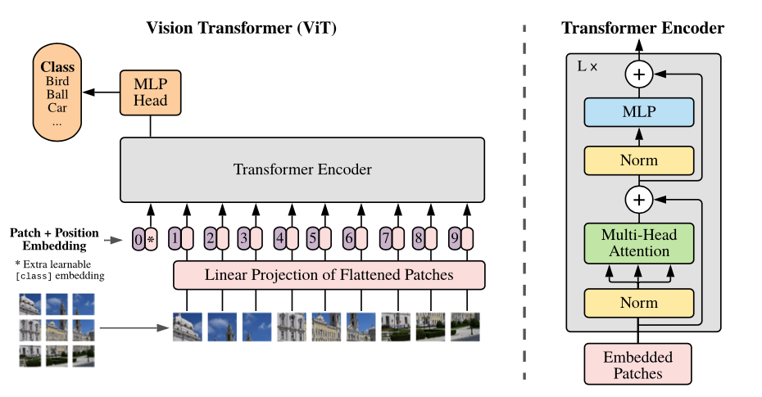
Model Architecture
Aryan Ali B20279 Chest X-Ray Analysis Vivek Jaiswal B20172

Slide 31
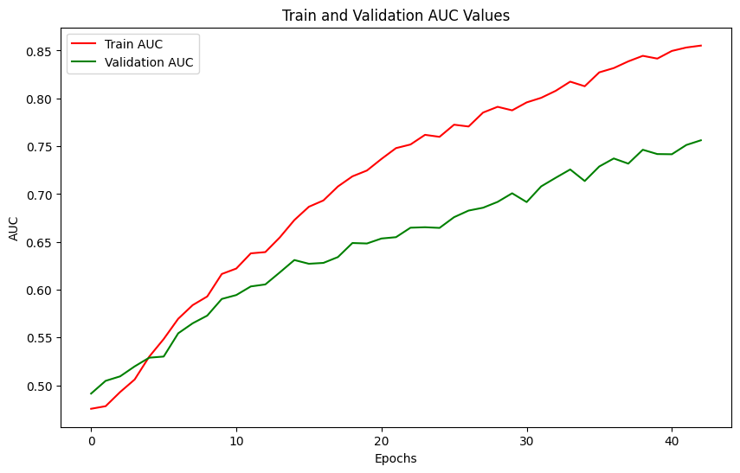
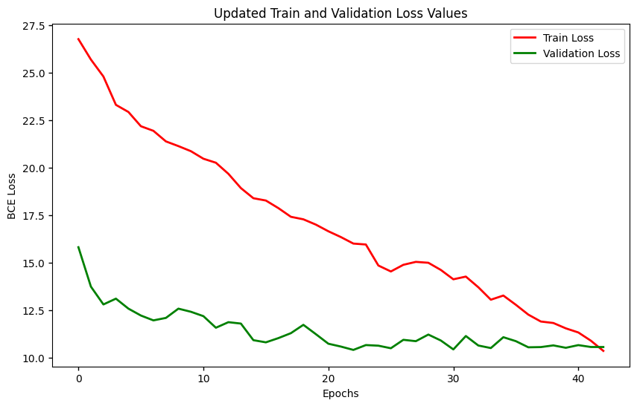
VIT Loss and AUC Plot
Aryan Ali B20279 Chest X-Ray Analysis Vivek Jaiswal B20172

Slide 32
Comparing AUC scores with other papers
Pathology | Yao et al. | CheXNet | GCN | DenseNet-121 | Inception Net v3 | ViT
Atelectasis | 0.772 | 0.8094 | 0.7514 | 0.7724 | 0.7693 | 0.7431
Cardiomegaly | 0.904 | 0.9248 | 0.8951 | 0.8827 | 0.8238 | 0.8917
Effusion | 0.859 | 0.8638 | 0.8574 | 0.857 | 0.8147 | 0.8139
Infiltration | 0.695 | 0.7345 | 0.6741 | 0.6843 | 0.6594 | 0.6875
Mass | 0.792 | 0.8676 | 0.5974 | 0.7897 | 0.7357 | 0.7882
Nodule | 0.717 | 0.7802 | 0.5742 | 0.7273 | 0.6971 | 0.7037
Pneumonia | 0.713 | 0.768 | 0.6847 | 0.7345 | 0.7261 | 0.6659
Pneumothorax | 0.841 | 0.8887 | 0.7765 | 0.8124 | 0.7917 | 0.8381
Ref : Rajpurkar, P., Irvin, J., Zhu, K., Yang, B., Mehta, H., Duan, T., Ding, D., Bagul, A., Langlotz, C., Shpanskaya, K. and Lungren, M.P., 2017. Chexnet: Radiologist-level pneumonia detection on chest x-rays with deep learning. arXiv preprint arXiv:1711.05225.
Aryan Ali B20279 Chest X-Ray Analysis Vivek Jaiswal B20172

Slide 33
Generating Bounding Box
We had utilized heatmap generated by Gradcam.
Dynamic threshold selection, scaling the global peak by 0.9, ensures robust heatmap analysis, capturing local maximum points effectively for accurate feature identification.
Utilizes morphological operations and dilation to accumulate local maxima, selecting centroids for precise bounding box placement, enhancing localization accuracy.
Recognizes disease-specific characteristics, introducing fixed-size bounding boxes adaptively calculated from local maxima, ensuring consistent and accurate predictions.
Ref : Tamura, Masato, and Tomoaki Yoshinaga. "Segmentation-based bounding box generation for omnidirectional pedestrian detection." The Visual Computer (2023): 1-12.
Aryan Ali B20279 Chest X-Ray Analysis Vivek Jaiswal B20172

Slide 34
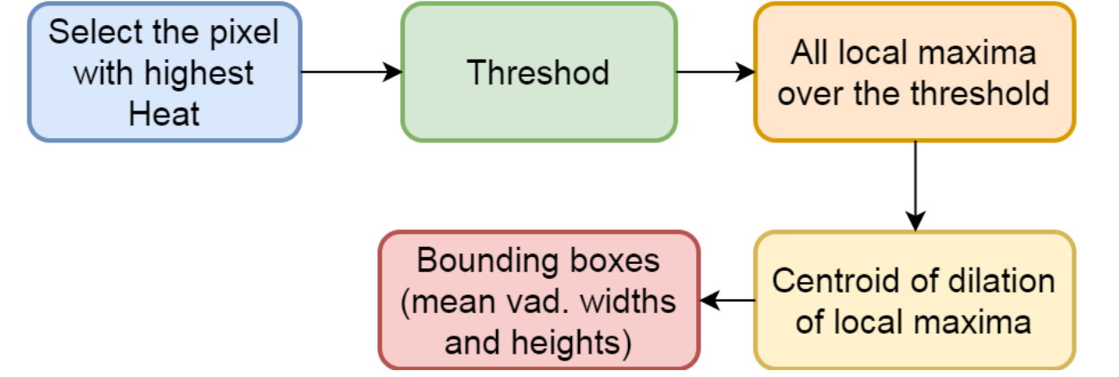
Bounding Box Generation Workflow
(Local Maxima + Average Box Algorithm)
Threshold
Generate bounding boxes
Centroid of local maxima
Aryan Ali B20279 Chest X-Ray Analysis Vivek Jaiswal B20172

Slide 35
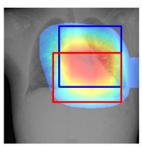
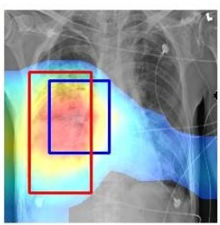
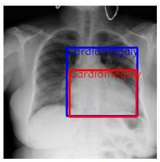
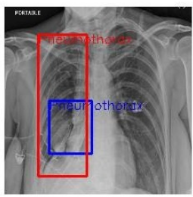
Bounding Box Output employing ChexNet
Heatmap
Our IoU for Bounding Boxes : 0.3347
CheXNet IoBB: 5.6348
Bounding Box
Ref : Rajpurkar, P., Irvin, J., Zhu, K., Yang, B., Mehta, H., Duan, T., Ding, D., Bagul, A., Langlotz, C., Shpanskaya, K. and Lungren, M.P., 2017. Chexnet: Radiologist-level pneumonia detection on chest x-rays with deep learning. arXiv preprint arXiv:1711.05225.
Aryan Ali B20279 Chest X-Ray Analysis Vivek Jaiswal B20172

Slide 36
Challenges and Limitations
Class imbalance in the dataset leads to bias degrading the results for some abnormalities in multiclass classification. Implemented weighted binary cross entropy as a loss function to overcome it up to some extent.
Limited research work on bounding box generation for pixel level segmentation on NIH CXR-dataset. Utilised available research on segmentation and classification fill that.
Aryan Ali B20279 Chest X-Ray Analysis Vivek Jaiswal B20172

Slide 37
Timeline and Milestone
August - September 2023
October 2023
November - December 2024
Feb - March 2024
March-April 2024
Transformer and inception integration
Implemented Bounding Box generation Algorithm
Study research papers & Finalizing problem statement
Training Models for lung segmentation
Trained models for chest x-ray classification
Aryan Ali B20279 Chest X-Ray Analysis Vivek Jaiswal B20172

Slide 38

THANK YOU
Aryan Ali B20279 Chest X-Ray Analysis Vivek Jaiswal B20172

